Slide 1
Marketing Initiatives
Growing the USPS Brand
2017 Annual Meeting
Orlando, FL
Paul Mermelstein SN, Marketing Chair
Tammy Brown, Marketing Director

Slide 2

Our Biggest Challenge
Stay relevant!
Relevant organization
Relevant offerings
Relevant relationships
So how do we do this?

Slide 3

Hatch Our Next New Idea?

Slide 4

Dress Up What We Already Have?

Slide 5
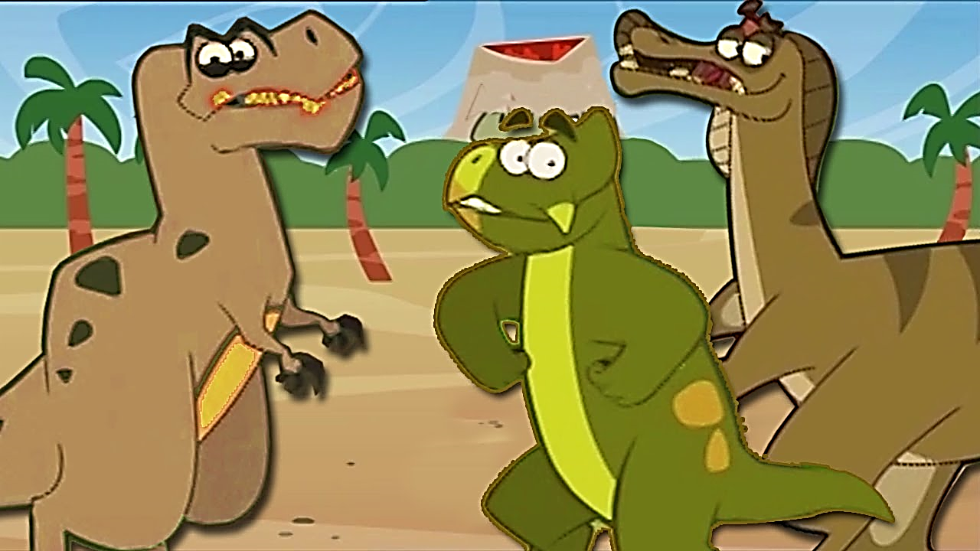
More Meetings?

Slide 6





We Need to Evolve - Quickly
Evolve our relevance
Re- establish name recognition
Modernize our image
Provide what people want
Be entrepreneurial

Slide 7
What’s Going On …
Hired R+M Agency
Assembled high level project teams
Completed strategic assessment
Obtained funding
  Endowment Fund
  Educational Fund
  THANK YOU!!!
Tackling big picture issues
  Re-visioning
  Re-branding and image
  Better communication
  More relevant offerings
  Tagline
  Organization name?

Slide 8
Results
Comprehensive market research
Organization personality statement
Positioning in the market place
Target markets/audiences
Messaging and brand statements
Inventory of current offerings & programs
Assessment of communication processes

Slide 9
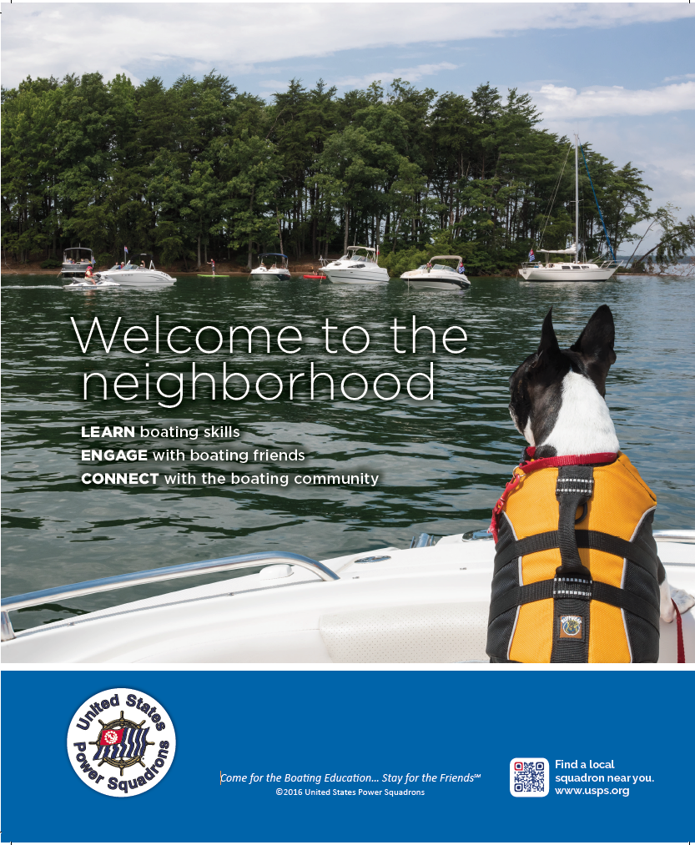
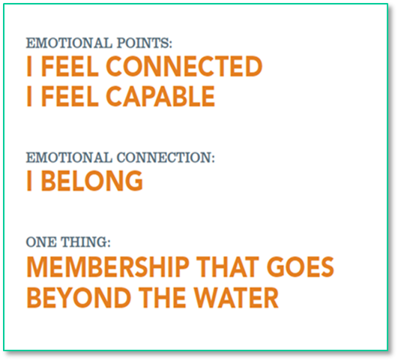


USPS Poster and Advertisement

Slide 10
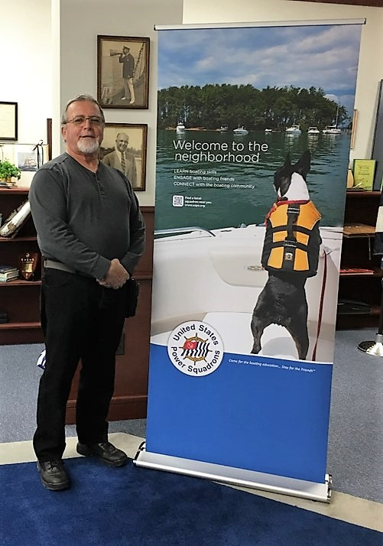
Pop Up Banners
Inexpensive FedEx contract
Use at boat shows, meetings, conferences, and everywhere
FREE to 100 squadrons
102

Slide 11
What’s Next
Advertising and promotion for recruiting
Updated website
Internal marketing for retention and squadron marketing support

Slide 12
Advertising & Media Plan
Squadrons – popups, banners, etc.
Partner-hosted ads
Videos
  Links from DML
  New promotional videos
New marketing-oriented public website
Expand social media
Media Buy – Print, Online, & Social Media

Slide 13

Media Buy
Large reach in print and online
Research/Metrics
Content creation
Content distribution

Slide 14
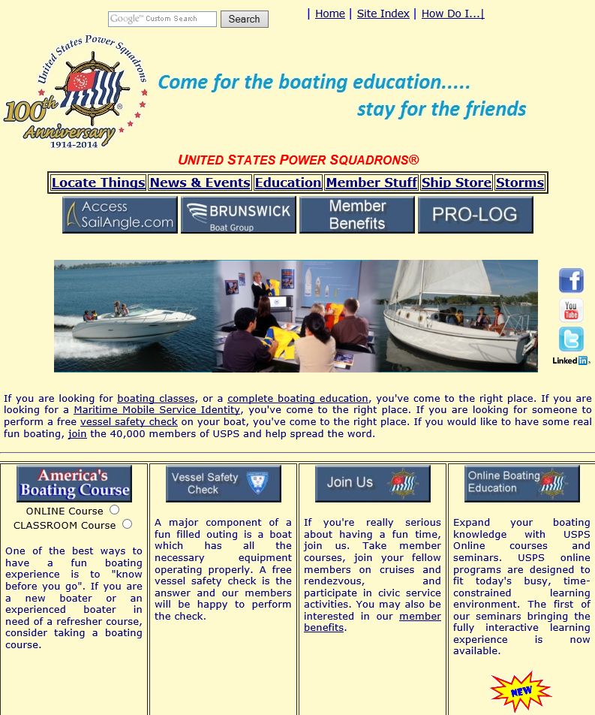

Website
USPS 3.0:
Marketing-centric
Intuitive, user friendly
Builds on new USPS marketing direction/themes
Cross platform compatible
Dynamic - changing content
Integrates with social media
SEO, Google Analytics, metrics
Flexible CMS
Robust security

Slide 15
Internal Marketing
New brochures & templates
  Squadron, District, and National levels
  Both print and online promotion
Squadron marketing support
Marketing for member retention

Slide 16

Next Steps
Finalize priorities
Organize resources
Update and finalize media and consulting contracts
Develop new public website
Everything else we have to do …

Slide 17
Thank You

